Slide 1
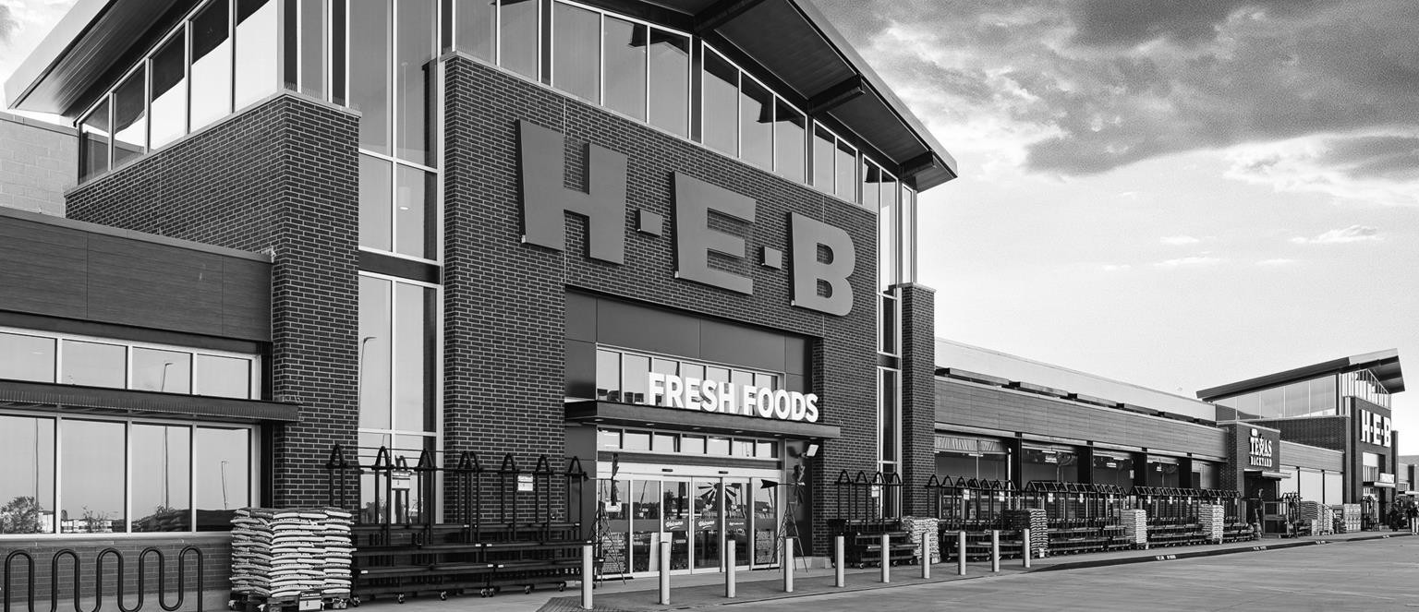


CUSTOMER OBSESSION
Weekly Status Report – Cost, Supplier, Pricing, Wentworth, Location, Pharmacy, GSS and PAM
HEBXXX-SUST-0002-00
01 AUG 2025

Slide 2
Index
03 Cost Core Service CHEDR (Haskell) | 05 Supplier Core Service QA and SPUR (Haskell) | 08 Pricing Core Service (Haskell and Java)
09 Wentworth (Haskell) | 10 Location Core Service (Java and Angular) | 11 Pharmacy and Wellness (iOS and QA)
13 Global Sourcing Solution | 14 Product Attribute Management (QA) | 15 LoCo (BSA)
16 Matters of Attention | 16 Team Allocation

Slide 3
Delivery Status - { Track Name }
Highlights | Overall Status
 | Last Week | This Week
{ Sprint Name }, { Status } ({ From Date } – { To Date }) Stories (Total – { Count }, Completed – { Count }, In-review – { Count }, In-progress – { Count }) Current week sprint status Stories completed this week– { Completed Count } stories { Completed Story Title } Stories released for Partner review this week – { In-Review Count } stories { In-Review Story Title } Stories in-progress – { In-Progress Count } stories { In-Progress Story Title }
Key Activities for Next Week
{ In-Progress Story Title }

Slide 4
Delivery Status
Matters of Attention | RAID Status
None to report | Last Week | This Week
Team Allocation
# | Name | Skillset | Track | Billable count
1 | Karthic Kumar | Haskell | Supplier Core Service | 2
2 | Akash Verma
3 | Rishi Manoj
4 | Arjun P Khandkar | Haskell | Cost Core Service | 4
5 | Althaf Hussain
6 | Sparsh Tandon
7 | Nishant Kaushik | Haskell | Wentworth | 1
8 | Vijai Krishna | Haskell | Pricing Core Service | 1
9 | Imthiyaz A S
10 | Balu S Kumar | QA Automation | Supplier Portal | 2
11 | Vineed Kaladharan | AngularJS
12 | Noblevincent Vincent |  | Location Core Service | 3
13 | Vignesh Krishnan | Java
14 | Arshana Kizhakkiniyakath
15 | Remya Karuppayil | QA | Pharmacy & Wellness | 3
16 | Gisha Sankaran
17 | Kumar K Singh | AngularJS | GSS | 1
18 | Vinu Lalitha | QA | Product Attribute Management | 1
19 | Sifat Billah Chowdhury | BSA | Location Core Service | 1
20 | Shivaraj Kumarappa | Delivery Lead | All Tracks | 1
Total |  |  |  | 20

Slide 5

WWW.G10X.COM

